Slide 1
CS 551
Spring 2025

Slide 2
Command line arguments

Slide 3
std::env::args()
Returns an iterator of the command line arguments passed in
How do we transform an iterator into a collection?
iterator.collect()
The first item in the iterator will the name of the binary
This is same as C

Slide 5
Let’s bring in the std::env module

Slide 6
Call the std::env::args() function to get an iterator of the command line arguments

Slide 7
Transform this iterator into a collection

Slide 8
Loop through the command line args and print out their index and value

Slide 9
Will it compile?

Slide 10
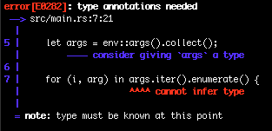

Slide 11
Indeed, we cannot infer what args is beyond being a collection of some sort

Slide 13
Annotate type of args variable and we are good to go

Slide 14
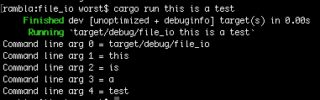

Slide 15
Files

Slide 16
Working with files
std::fs is the namespace that has most things having to do with files.
There’s the basic functionality you would expect
Opening and closing
Reading/writing
Getting a line vs reading the entire file in, etc.

Slide 18
Let’s try to read in a file that we pass on the command line

Slide 19
fs::read_to_string() is a function that opens whatever path you send in and returns a string that contains the contents of the file

Slide 20
Will it compile?
Think about places where an Err occur

Slide 22
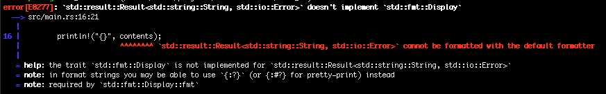

Slide 23
contents is a Result, same like we saw when we tried to read from stdin

Slide 24
read_to_string() is going to Err out in certain cases?

Slide 25
When would this error?

Slide 26
File not found?
Don’t have permissions?
Some kind of disk error?

Slide 27
How can we fix?
Think back to the stdin() error handling

Slide 28
Now we need to read something in!

Slide 30
We can use .expect()

Slide 32
It ran, but we got a panic! We tried to read from a file and got a file not found error!

Slide 33
How do we know which file was not found?
We can’t tell from this?

Slide 34
What is another we can handle errors?

Slide 36
We can use pattern matching!

Slide 37
Now we can trigger our own panic!() which will “crash” the program and spit out a string

Slide 38
I snuck this in here.
It is pretty self explanatory I think?

Slide 39
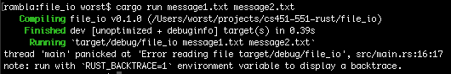

Slide 40
Remember the first item in the env::args() is going to be the name of the binary!

Slide 42
Let’s fix this by slicing the args vector from index 1 to the end of the argument list

Slide 44
Often times, we just kinda want to get the value and propagate an error

Slide 45
The ? operator in Rust gives us this functionality.
It’s short hand that can make development quicker

Slide 46
But there are some caveats with using ?

Slide 47
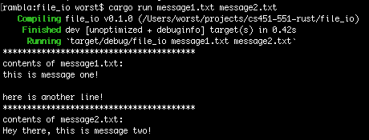

Slide 48
The biggest one is that any function that uses it has to return a Result

Slide 49
Basically, ? is shorthand for the match statement

Slide 50
? is shorthand for:
match some_result {
Ok(v) => Ok(val_to_return),
Err(e) =>return Err(e),
}

Slide 51
Reading from a file
Reading from a file is (duh) super common
fs:: gives us a bunch of other stuff we can do
E.g., we would like to read some number of bytes from a file into a buffer
We can use File.read(buffer)

Slide 53
Function that will read a file byte by byte and return the bytes that it read

Slide 54
Note various uses

Slide 55
We are going to take in a &str that is the path to the file we want to read

Slide 56
We are going to return a Result that contains a Vec<u8> (a vector of bytes) if everything went well, and an io::Error if it fails

Slide 57
We open the file here
Note the ?

Slide 58
Now we’ll declare a Vec<u8> that we will return to the caller

Slide 59
Note the syntax:
vec![value; initial_capacity]
This will make a new Vec of length initial_capacity and fill it with whatever value is

Slide 60
0u8 is saying our initial value should be 0 and it should be of type u8

Slide 61
Semi-colon used by the vec! macro to separate args

Slide 62
We want our initial capacity to be 0 (empty)

Slide 63
There are lots of ways to read into a buffer, but here’s one

Slide 64
We declare an array of u8 with a length of 1

Slide 65
I.e., an array of bytes with only a single element

Slide 66
File.read(buffer) takes in a mutable reference to an array (works with Vec too)

Slide 67
It returns the number of bytes that were read.
0 bytes read = EOF

Slide 68
We now append whatever is in the buffer to our bytes Vec

Slide 69
Then we send back an Ok(bytes) to our caller
Caller can unwrap() the result to get at the bytes

Slide 71
When we call read_byte_by_byte() we need to either use ? or handle the Result that comes back ourselves

Slide 72
Assuming we have used the ? operator, what is the type of bytes?

Slide 73
Vec<u8>

Slide 74
We can print to standard err with the eprintln! macro

Slide 75
We can write the bytes we got back to stdout using the write() method

Slide 76
Note that Files and other types of IO have essentially the same API

Slide 77
We gotta remember to return something that is a Result

Slide 78
In this case, we just want to return Ok(())

Slide 79
What is the inner () in this line called?

Slide 80
There are a bunch of ways to implement the read_byte_by_byte function.
Any other ideas?

Slide 81
There are a bunch of ways to implement the read_byte_by_byte function.
Any other ideas?
Could we loop a different way?

Slide 82
There are a bunch of ways to implement the read_byte_by_byte function.
Any other ideas?
What about using a bigger buffer to read into?

Slide 84
Let’s try reading in at most 8 bytes at a time

Slide 85
We can use a loop and a match to handle things

Slide 86
We are matching on the return value of f.read()

Slide 87
f.read() returns the number of bytes read

Slide 88
The return value is bound to num_bytes_read

Slide 89
Pattern matching is really powerful!
You can use conditionals!

Slide 90
This expression gets run if and only if we read in 0 bytes

Slide 91
If we managed to read in more than 1 byte, this expression is run

Slide 92
We are going to extend() our return value with the bytes we read in

Slide 93
We might not have read all 8 bytes, so we can use a slice to only append the number of bytes we read

Slide 94
We do still need to handle other values that might occur in our match

Slide 95
There is nothing we could do in that scenario, and in fact it makes no sense in reality

Slide 96
So we will just panic! and get out of the program

Slide 97
What if we wanted to read only a certain number of bytes from the file?

Slide 98
Function that reads n bytes
Let’s assume the function takes in a fs::File and a u32 for the number of bytes to read
What might function signature look like?
fn read_bytes(file: &mut fs::File, num_to_read: u32) -> ?
fn read_bytes(file: &mut fs::File, num_to_read: u32) -> Result<Vec<u8>, io::Error> { … }

Slide 100
We are going to return a Result that either has a Vec<u8> or an io::Error again

Slide 101
We are going to read one byte a time

Slide 102
Instead of 1, do you think we could have just put num_to_read?

Slide 103
Nope, arrays have a static size, because they are on the stack.

Slide 104
Can only have a constant here otherwise the compiler can’t figure out how much to put on the stack

Slide 105
Let’s keep track of the number of bytes we have read

Slide 106
Let’s loop until we have read in the number of bytes specified

Slide 107
Here, we can use a match again!

Slide 108
If we read 0 bytes, then we have reached the end of the file and should break, no matter how many we have already read

Slide 109
For anything else, we can just extend the Vec that we are returning and increment our counter

Slide 111
Let’s add a new match arm for when we have 3 arguments

Slide 112
First command line argument will still be the file name

Slide 113
Have the second argument be the number of bytes to read

Slide 114
We need to parse the string that comes in on command line to a u32 as we did in earlier slides

Slide 115
Remember to use the ? operator when it can make your life easier!

Slide 116
Performance benchmarking
There are N different ways to do stuff with files
How do we tell which is the “best?”
We can do some benchmarking.
Let’s try using hyperfine https://github.com/sharkdp/hyperfine
Written in rust ☺
cargo install hyperfine
hyperfine ’program1 args’ ‘program2 args’

Slide 117
Some issues!
Can anyone think of any issues we might need to consider when benchmarking our file reading/writing functions?
Think about it in terms of OS stuff…
What are the implications of OS file caching?

Slide 118
File operations
dd if=/dev/urandom of=1GB.txt bs=1M count=1000
Clear file cache
Linux: sync; echo 3 | sudo tee /proc/sys/vm/drop_caches
macOS: sync && sudo purge
hyperfine –prepare ‘sync && sudo purge’ ‘program1 args’ ‘program2 args’

